Slide 1
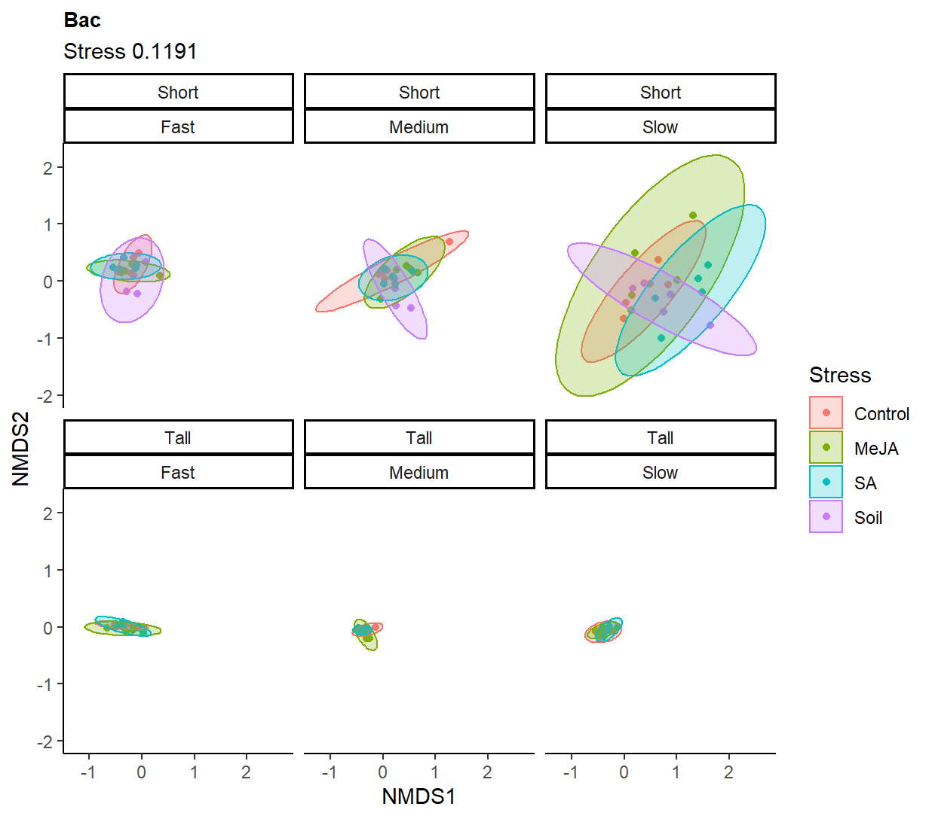
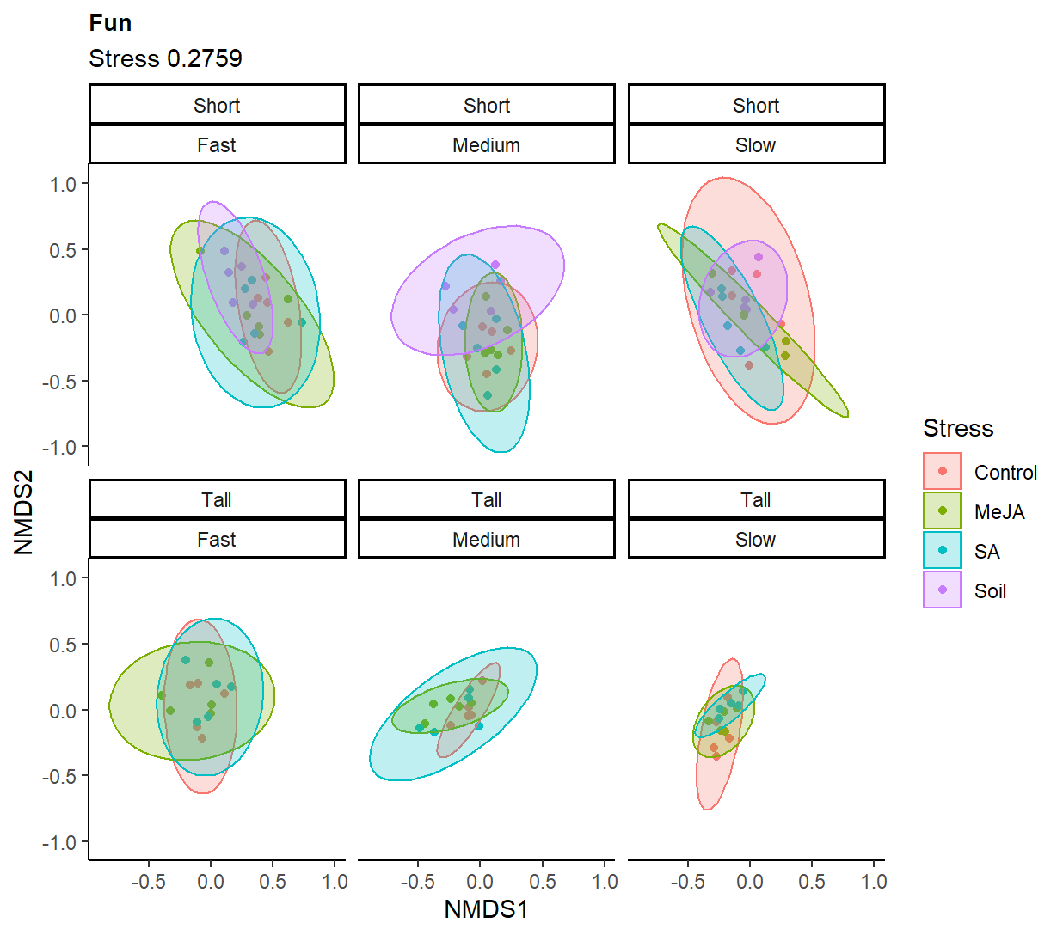
"bray") ~ Stress * is_tall_plant + Block
Stress | 3 | 1.1043 | 0.04412 | 1.6441 | 0.001 | ***
is_tall_plant | 1 | 1.5645 | 0.0625 | 6.9878 | 0.001 | ***
Block | 4 | 0.9035 | 0.03609 | 1.0088 | 0.001 | ***
Stress:is_tall_plant | 2 | 0.4144 | 0.01655 | 0.9254 | 0.794
Stress | 3 | 0.9289 | 0.03429 | 1.2392 | 0.02 | *
is_tall_plant | 1 | 1.2096 | 0.04465 | 4.8408 | 0.001 | ***
Block | 4 | 0.9777 | 0.03609 | 0.9782 | 0.001 | ***
Stress:is_tall_plant | 2 | 0.488 | 0.01801 | 0.9765 | 0.569

Slide 2
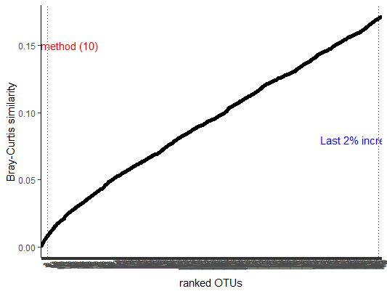
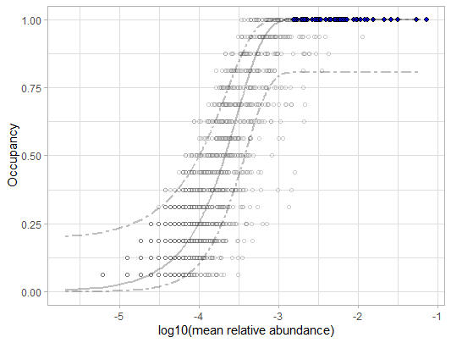
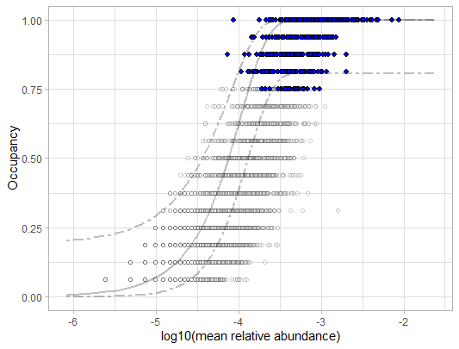
F5.MeJA, Greenhouse compartment
Pre-plantin soil, harvest ID
Same output if setting the core prioritization by greenhouse compartment, greenouse table, or harvest ID, for both F5.MeJA and pre-planting bulk soils. Only 15/44 ASVs in the core of F5.MeJA are not in the core of pre-planting

Slide 3
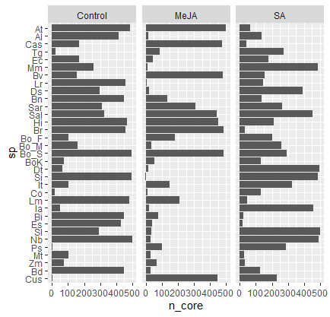
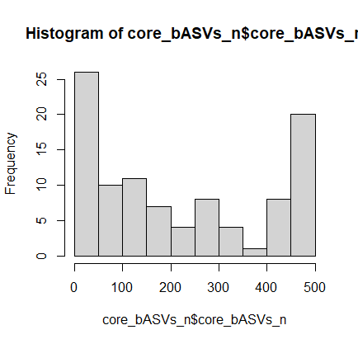
Size of the cores. This is a very odd distribution. Why would it be so common to have one stress with a much smaller core?

Slide 4
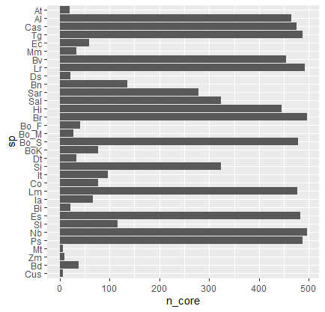
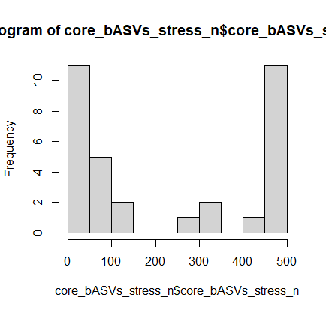
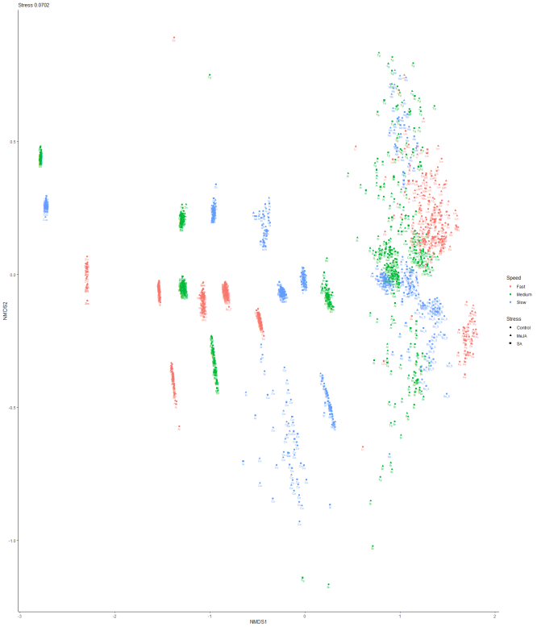
If 33 per-species cores are defined per stress, we still see this strainge distribution

Slide 5
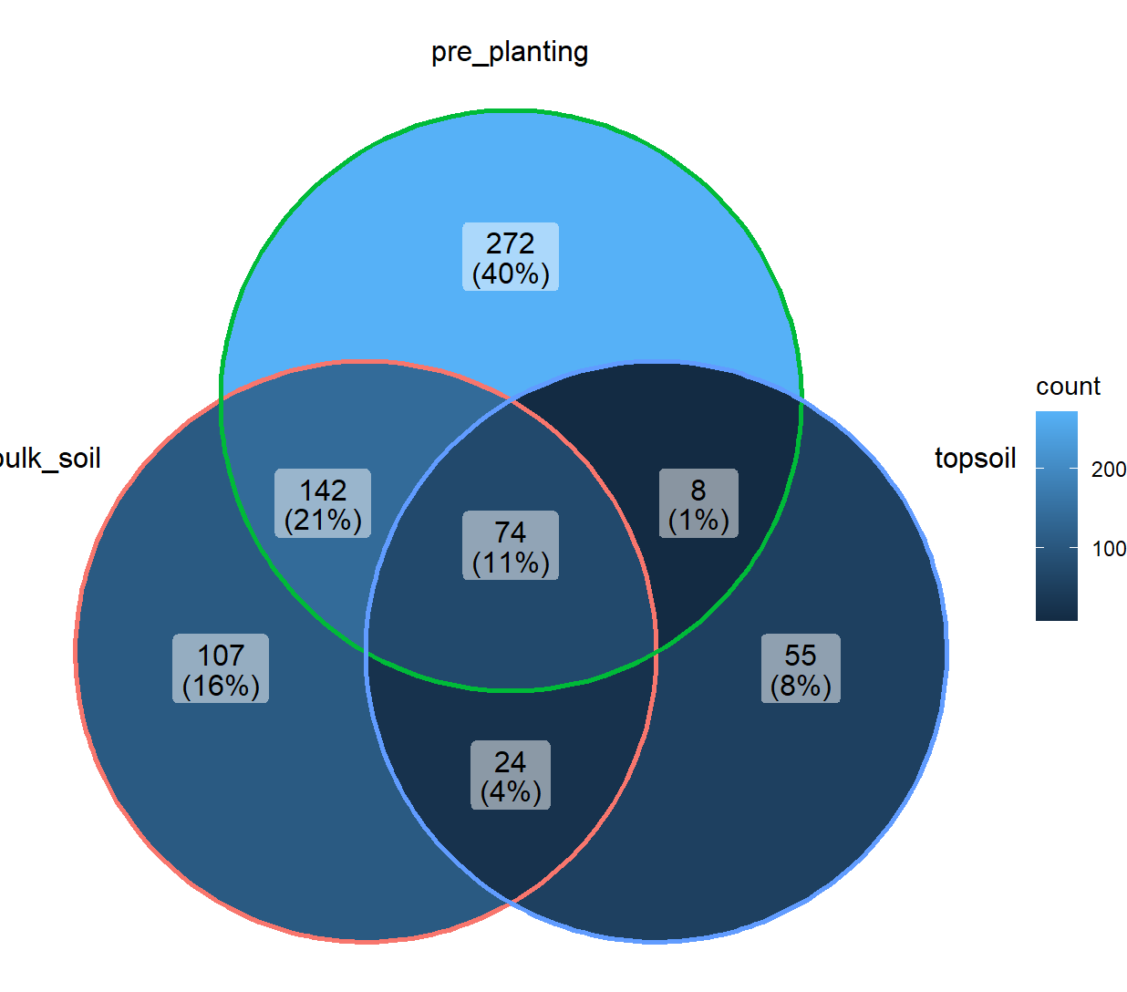
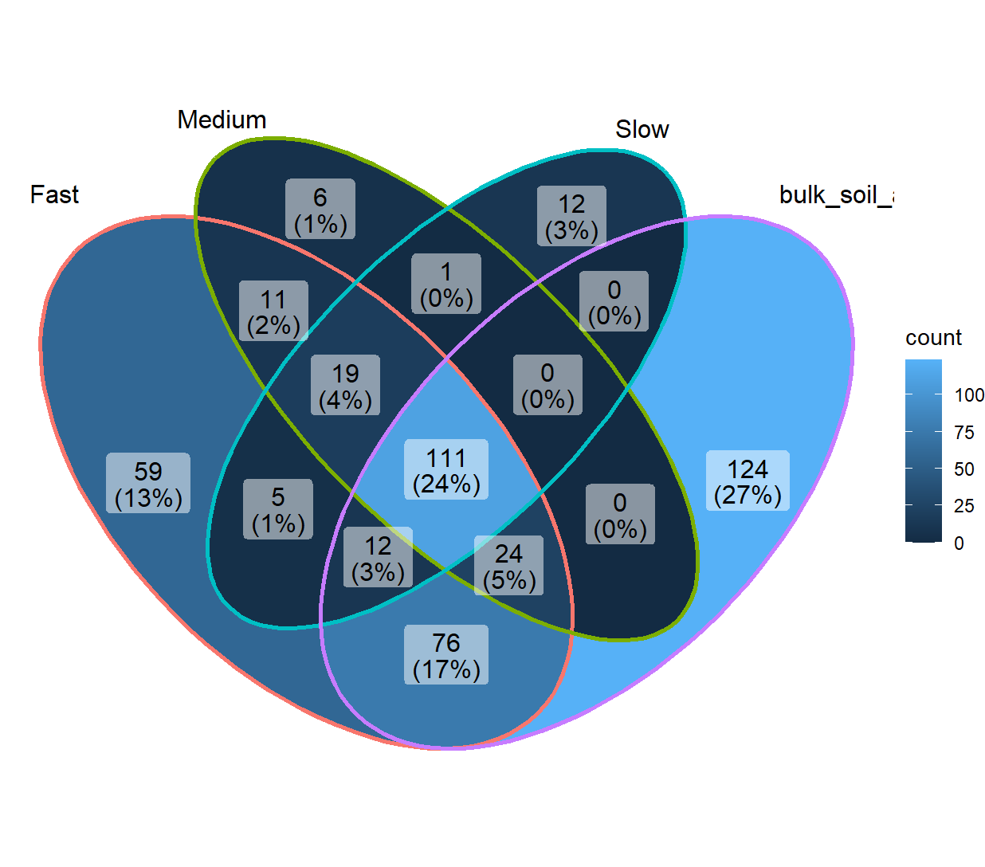

Slide 6
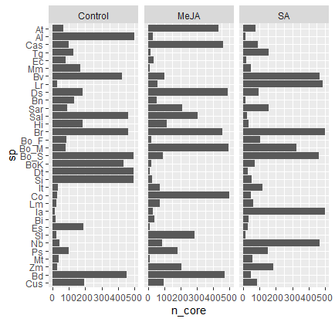
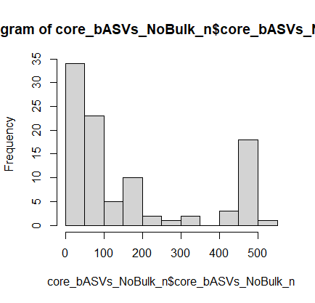
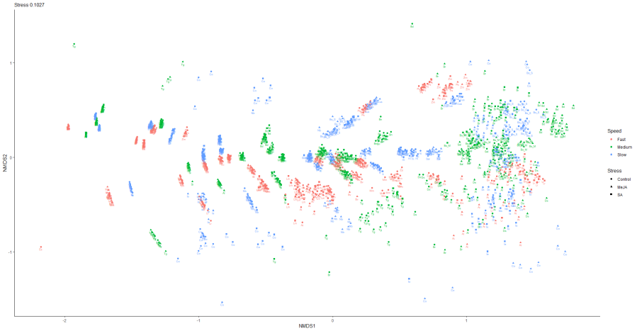
After removing bulk soil core bASVs we still have an odd distribution to core size
If we remove pre-planting and per-speed bulk soil cores, we still have this distribution
If we prioritize by greenhouse table instead, we have the same results

Slide 7
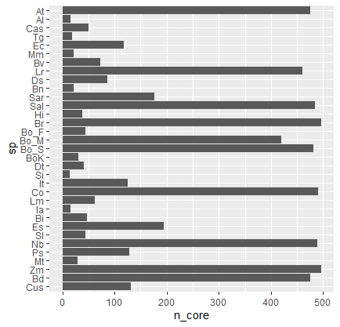
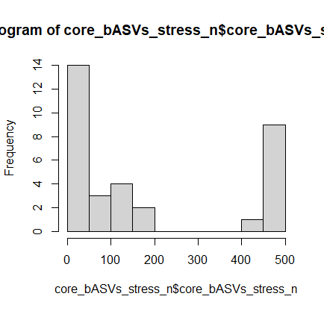
If we remove bulk soil core bASVs on the 33 spe split, we still see the odd distribution. How to explain at, that goes from ~7 core asvs to ~500?
Something is either too random or just plain wrong. Maybe the method is really sensible to rarefaction or high diversity?

Slide 8
normalization | Data Paritions | Bac or Fun | Number of input OTUs per data partition | number of samples per data partition | predicting | aver. N predictors | total unique ASVs | Acurracy | kappa | n trees boruta | time boruta 6 cores | time corss validation
CSS | 33 sp | Bac | 16225 ± 3613 | 46 | Stress | 18,96±12,02 | 457 | 0,803±0,098 | 0,705±0,148 | 10k | 70 min | 33 min
CSS | 33 sp | Fun | 723 ± 152 | 44 | Stress | 9,4±3,8 | 122 | 0,715±0,102 | 0,571±0,151 | 10k | ~20 min | 18 min
CSS | 3 lineages | Bac | 48487 / 60033 / 18232 | 442 / 750 / 47 | Stress | 31/42/3 | 70 (exluding lineage) III | 0,603/0,562/0,617 | 0,405/0,343/0,42 | 10k | 4h | 51 min
CSS | 3 lineages | Fun | 1752 / 2371 / 667 | 422 / 715 / 47 | Stress | 27/14/11 | 39 (exluding lineage) III | 0,589/0,486/0,783 | 0,382/0,230/0,680 | 10k | 1,5h | 26 min
CSS | full data, no parition | Bac | 69652 | 1519 | Stress | 34 | 34 | 0.514 | 0.272 | 10k | 6h | 70 min
CSS | full data, no parition | Fun | 2650 | 1476 | Stress | 83 | 83 | 0.589 | 0.384 | 10k | 8h | 3h
CSS | 33 sp | Bac | 16225 ± 3613 | 46 | Stress | 18,84±12,6 | 462 | 0,800±0,098 | 0,699±0,147 | 15k | 28h (8cores) | 44 min
CSS | 33 sp, no bulk ASVs | Bac | 15884 ± 3607 | 46 | Stress | 16,27±10,1 | 386 | 0,780±0,102 | 0,699±0,153 | 15k | 28h (8cores) | 44 min
Rarafied | 33 sp | Bac |  |  | Stress | 15,9+-9,8 | 397 | 0,780+-0,104 | 0,669+-0,156 |  | 1,6h | 22 min
Rarafied | 33 sp | Fun |  |  | Stress | 6,1+-2,4 | 100 | 0,628+-0,080 | 0,438+-0,120 |  | ~30 min | 15 min
Rarafied | 3 lineages | Bac |  |  | Stress | 25/33/3 | 55 (exluding lineage) III | 0,581/0,531/0,568 | 0,371/0,297/0,350 |  | 2.5h | 45 min
Rarafied | 3 lineages | Fun |  |  | Stress | 9/13/9 | 20 (exluding lineage) III | 0,490/0,466/0,694 | 0,238/0,200/0,542 |  | 40 min | 20 min

